Slide 1
Melting and crystallisation in geochemical systems: phase diagram applications
EART26201 | Principles of Geochemistry | Lecture 4
Part 1 | Introduction

Slide 2
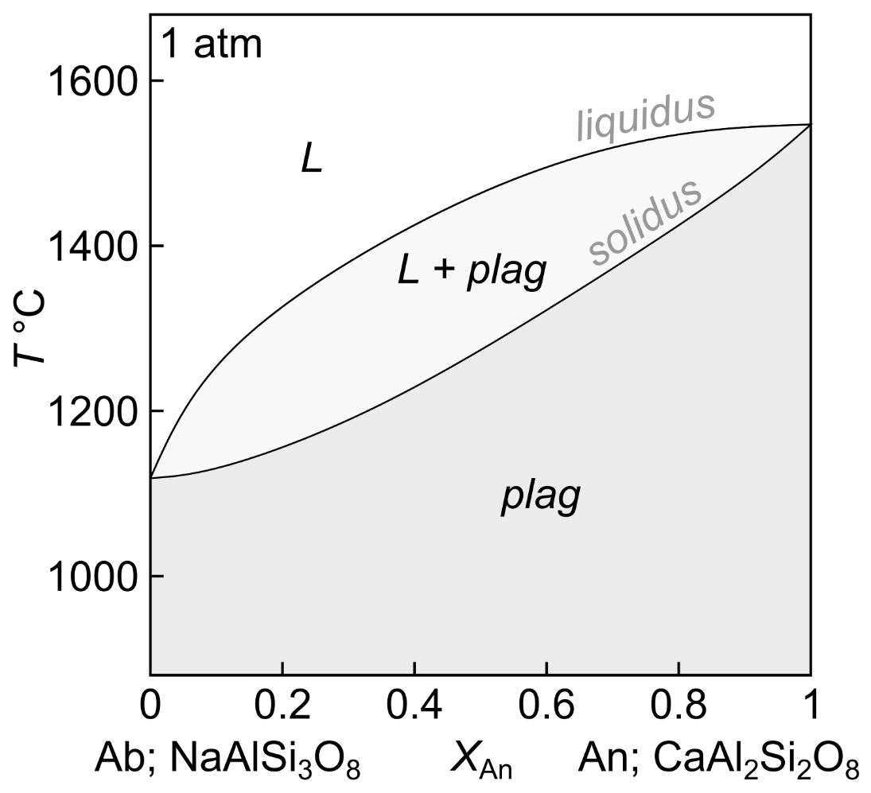
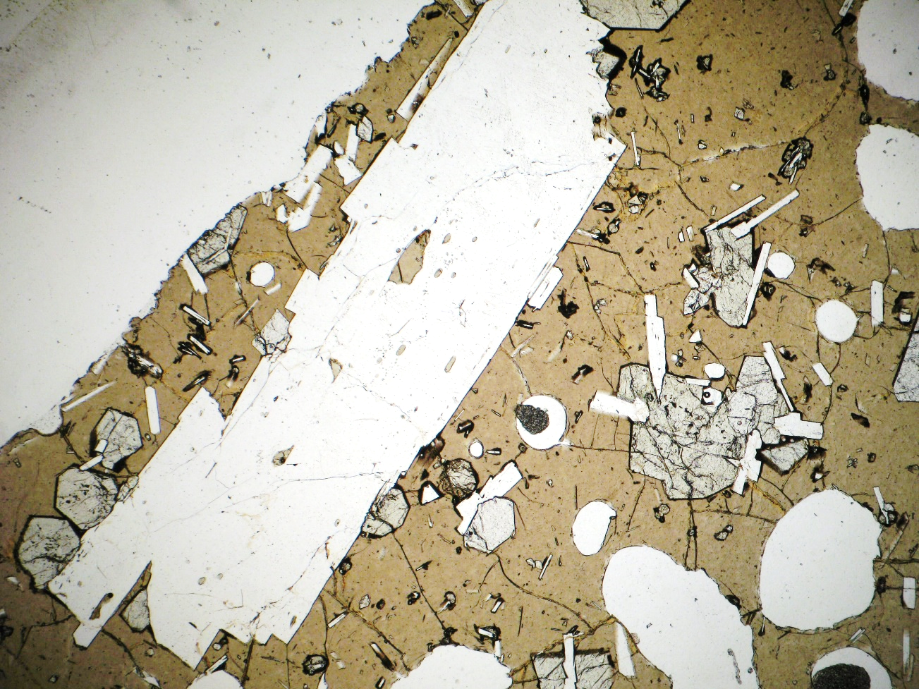
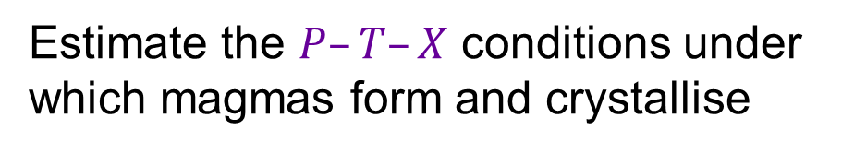
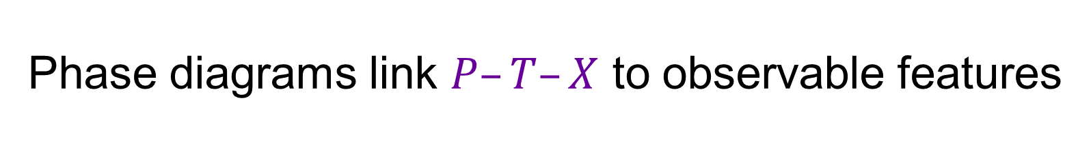
Phase diagrams link $P–T–X$ to observable features
Icelandic basalt
Plagioclase with
X_{An} = 0.9
Plagioclase with
X_{An} = 0.4
Estimate the $P–T–X$ conditions under which magmas form and crystallise

Slide 3
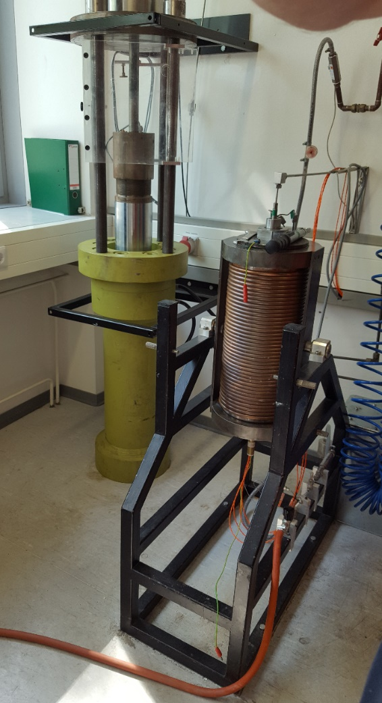
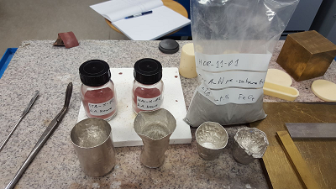
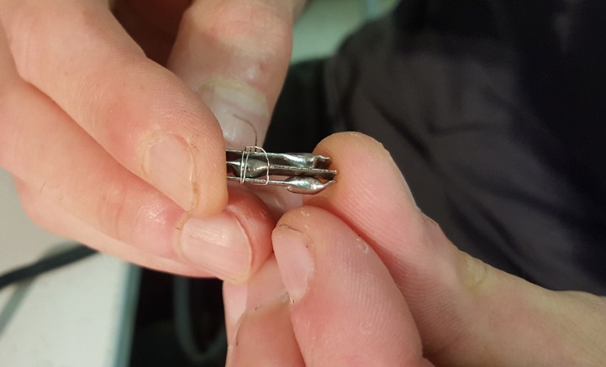
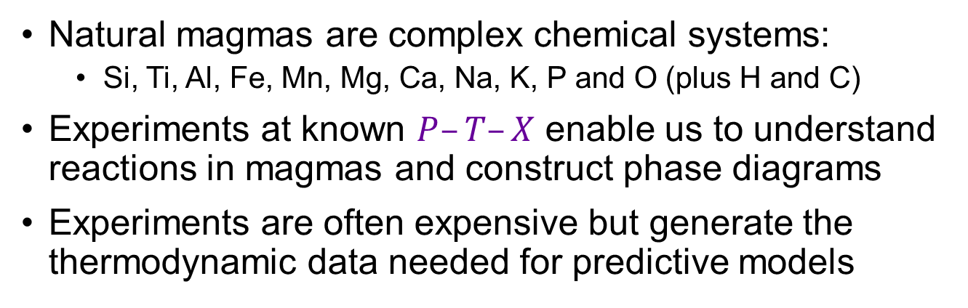
Using experiments to construct phase diagrams
Natural magmas are complex chemical systems:
  Si, Ti, Al, Fe, Mn, Mg, Ca, Na, K, P and O (plus H and C)
Experiments at known $P–T–X$ enable us to understand reactions in magmas and construct phase diagrams
Experiments are often expensive but generate the thermodynamic data needed for predictive models

Slide 4
Lecture 4 synopsis
Synchronous
Part 1 | Introduction
Part 2 | Phase diagrams without solid solution
Part 3 | Phase diagrams with a solvus
Part 4 | Pyroxenes and exsolution
Part 5 | Phase diagrams with a peritectic
Further reading | White, Chapter 4 (Phase diagram construction)

Slide 5
Melting and crystallisation in geochemical systems: phase diagram applications
EART26201 | Principles of Geochemistry | Lecture 4
Part 2 | Binary phase diagrams without solid solution

Slide 6

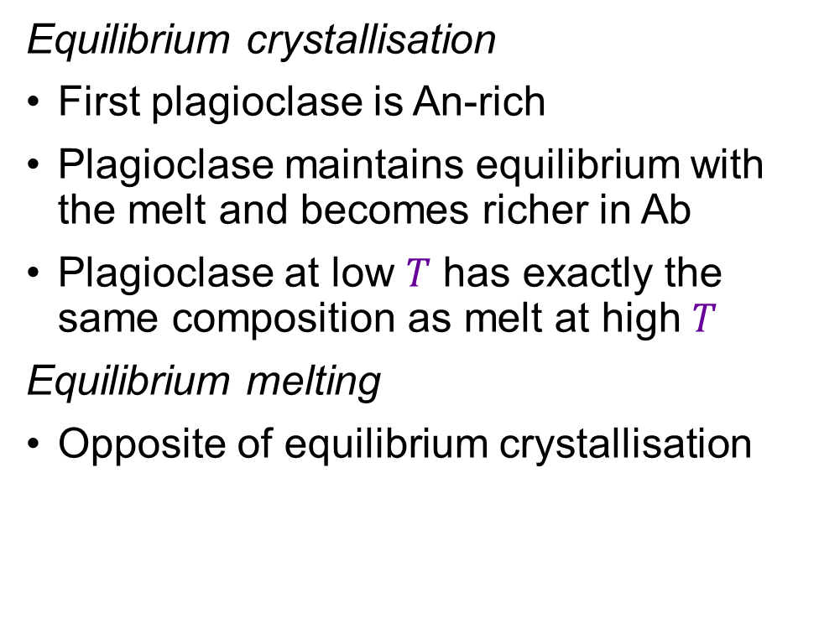
Binary phase diagram with solid solution: a recap
Equilibrium crystallisation
First plagioclase is An-rich
Plagioclase maintains equilibrium with the melt and becomes richer in Ab
Plagioclase at low $T$ has exactly the same composition as melt at high $T$
Equilibrium melting
Opposite of equilibrium crystallisation
L
T1
L1
Liquid
System
plag1
T2
L2
plag2
T3
L3
plag3
plag

Slide 7
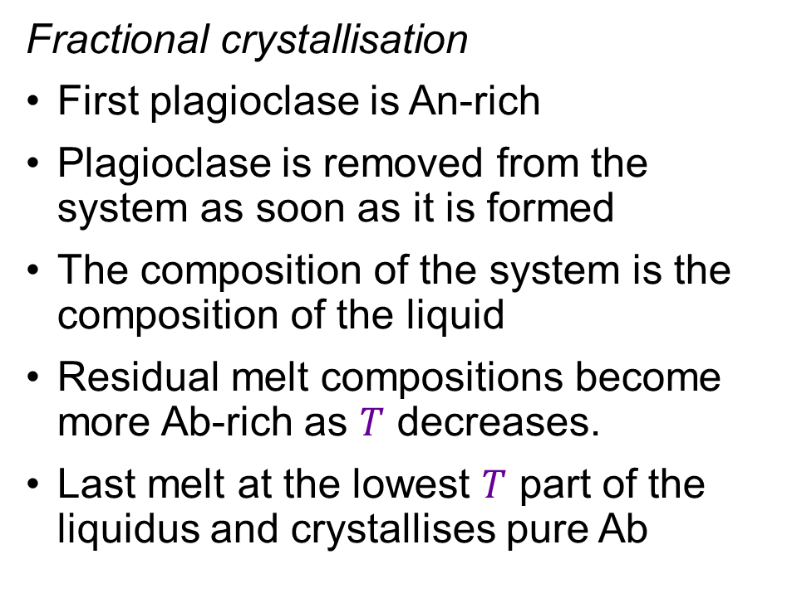
Binary phase diagram with solid solution: a recap
Fractional crystallisation
First plagioclase is An-rich
Plagioclase is removed from the system as soon as it is formed
The composition of the system is the composition of the liquid
Residual melt compositions become more Ab-rich as $T$ decreases.
Last melt at the lowest $T$ part of the liquidus and crystallises pure Ab
Liquid
=
System
L
T1
L1
plag1
T2
L2
plag2
T3
L3
plag3
T4
plag4

Slide 8
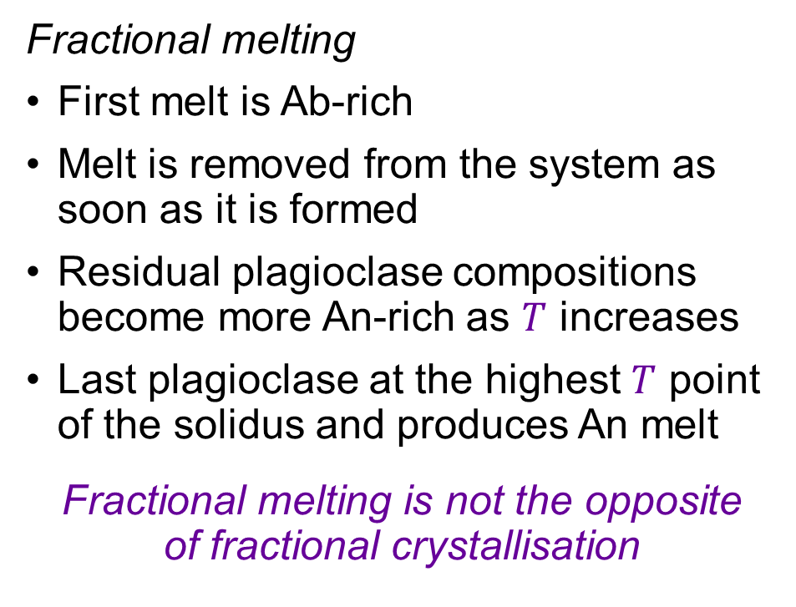
Binary phase diagram with solid solution: a recap
L
Fractional melting
First melt is Ab-rich
Melt is removed from the system as soon as it is formed
Residual plagioclase compositions become more An-rich as $T$ increases
Last plagioclase at the highest $T$ point of the solidus and produces An melt
Fractional melting is not the opposite
of fractional crystallisation
T4
L4
T3
L3
T2
L2
plag3
plag2
T1
L1
plag1
plag

Slide 9
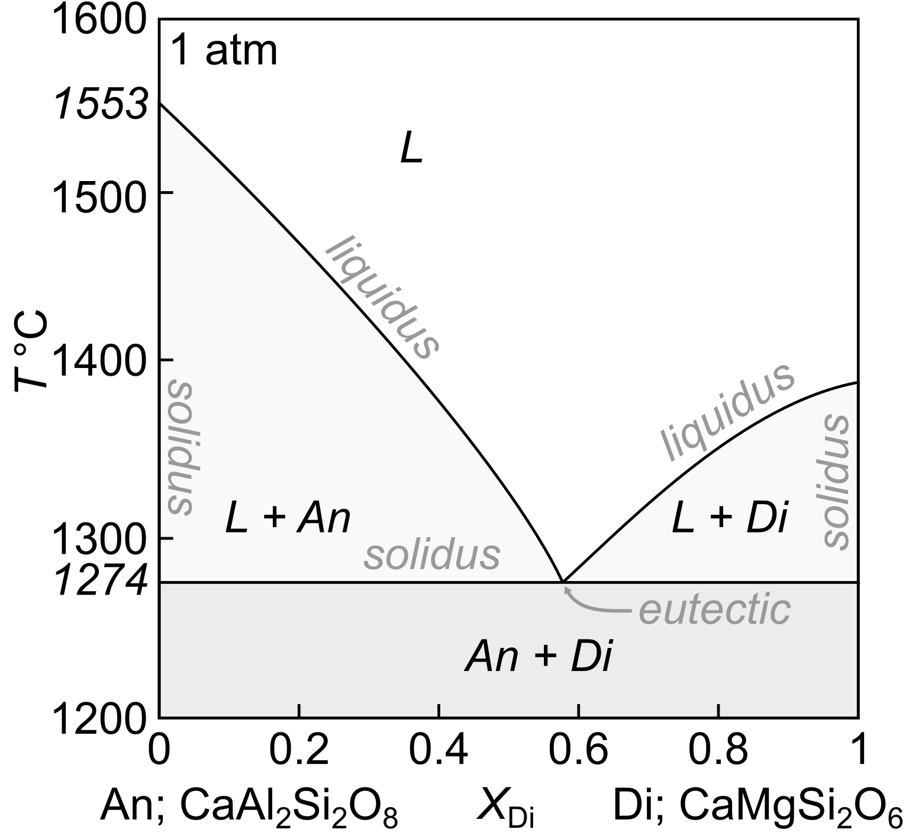
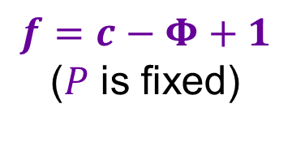
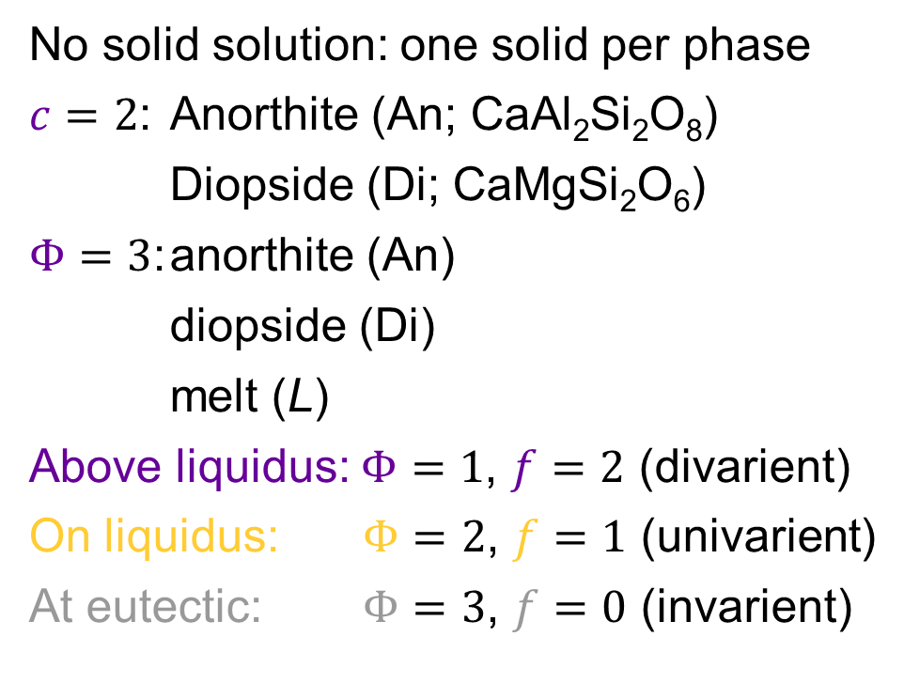
Binary phase diagram with no solid solution: An–Di
No solid solution: one solid per phase
$c=2$: Anorthite (An; CaAl₂Si₂O₈)
Diopside (Di; CaMgSi₂O₆)
$Φ=3$: anorthite (An)
diopside (Di)
melt (L)
Above liquidus: $Φ=1$, $f=2$ (divarient)
On liquidus: $Φ=2$, $f=1$ (univarient)
At eutectic: $Φ=3$, $f=0$ (invarient)
L
An
$$f=c−Φ+1$$
($P$ is fixed)

Slide 10

Binary phase diagram with no solid solution: An–Di
Equilibrium crystallisation
An₄₀Di₆₀ L → An + Di (eutectic)
An₇₀Di₃₀ L → An (liquidus)
L → An + Di (eutectic)
An₂₀Di₈₀ L → Di (liquidus)
L → An + Di (eutectic)
Lever rule for quantitative descriptions
Equilibrium melting
Opposite of equilibrium crystallisation
We’ll do this in the practical
System
Liquid
Solid
Liquid
System
Solid

Slide 11
Binary phase diagram with no solid solution: An–Di
Fractional crystallisation
An₄₀Di₆₀ L → An + Di (eutectic)
An₇₀Di₃₀ L → An (liquidus)
L → An + Di (eutectic)
An₂₀Di₈₀ L → Di (liquidus)
L → An + Di (eutectic)
Lever rule for quantitative descriptions
The composition of the system is the composition of liquid
Last liquid is always at the eutectic
Liquid
=
System
Liquid
=
System

Slide 12
Binary phase diagram with no solid solution: An–Di
Fractional melting
An₇₀Di₃₀ An + Di
An + Di → L (eutectic)
until Di is exhausted
An → L (liquidus)
until An is exhausted
last melt is of pure An
Fractional melting is not the opposite
of fractional crystallisation

Slide 13
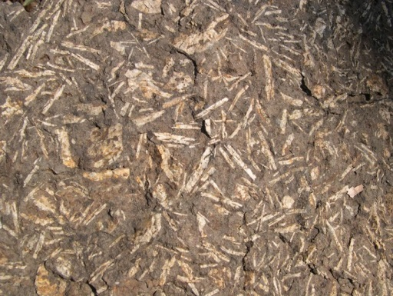
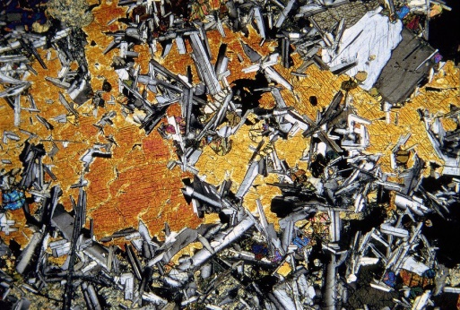
Phase diagrams and natural rocks
Basalt with plagioclase crystals
Basalt with intergrown plagioclase and clinopyroxene crystals

Slide 14
Melting and crystallisation in geochemical systems: phase diagram applications
EART26201 | Principles of Geochemistry | Lecture 4
Part 3 | Phase diagrams with a solvus

Slide 15

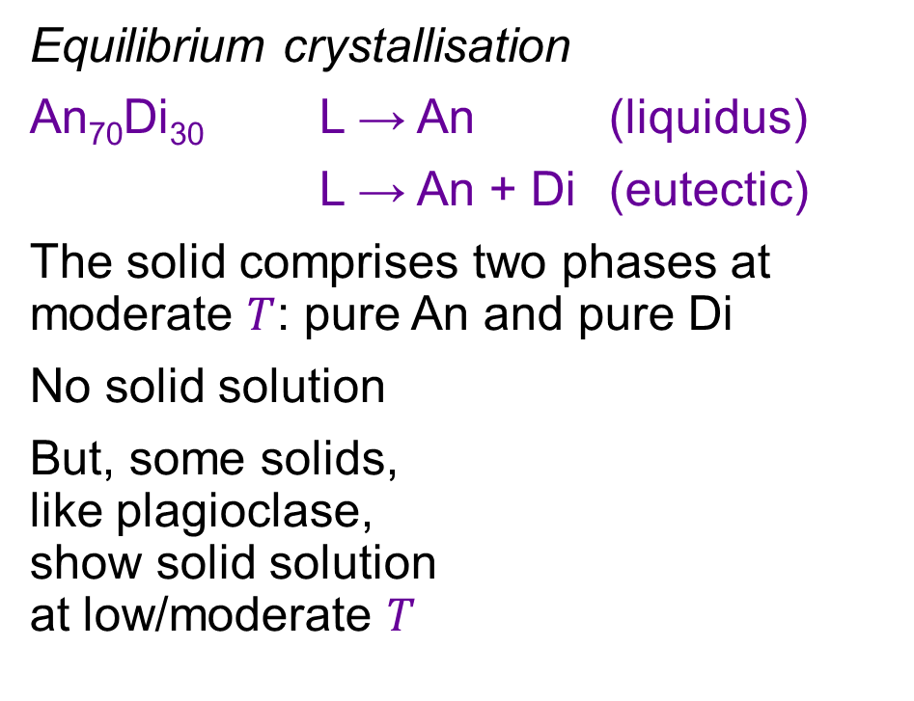
Binary phase diagram with no solid solution: a recap
Equilibrium crystallisation
An₇₀Di₃₀ L → An (liquidus)
L → An + Di (eutectic)
The solid comprises two phases at moderate $T$: pure An and pure Di
No solid solution
But, some solids,
like plagioclase,
show solid solution
at low/moderate $T$
System
Liquid
Solid

Slide 16
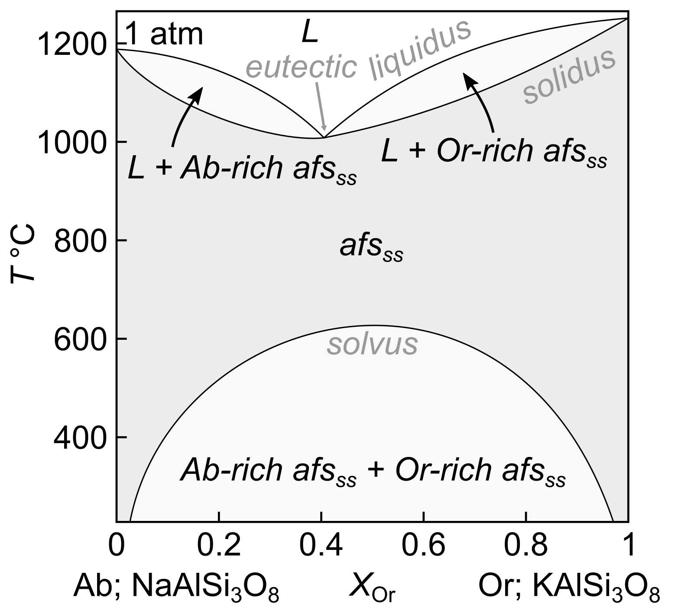
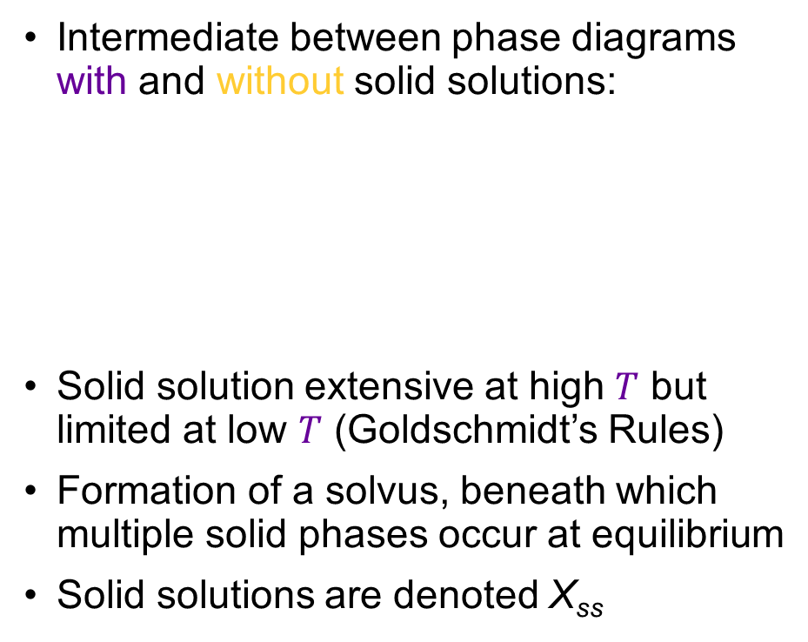
Binary phase diagram with a solvus: Ab–Or
Intermediate between phase diagrams with and without solid solutions:
Solid solution extensive at high $T$ but limited at low $T$ (Goldschmidt’s Rules)
Formation of a solvus, beneath which multiple solid phases occur at equilibrium
Solid solutions are denoted X_{ss}

Slide 17
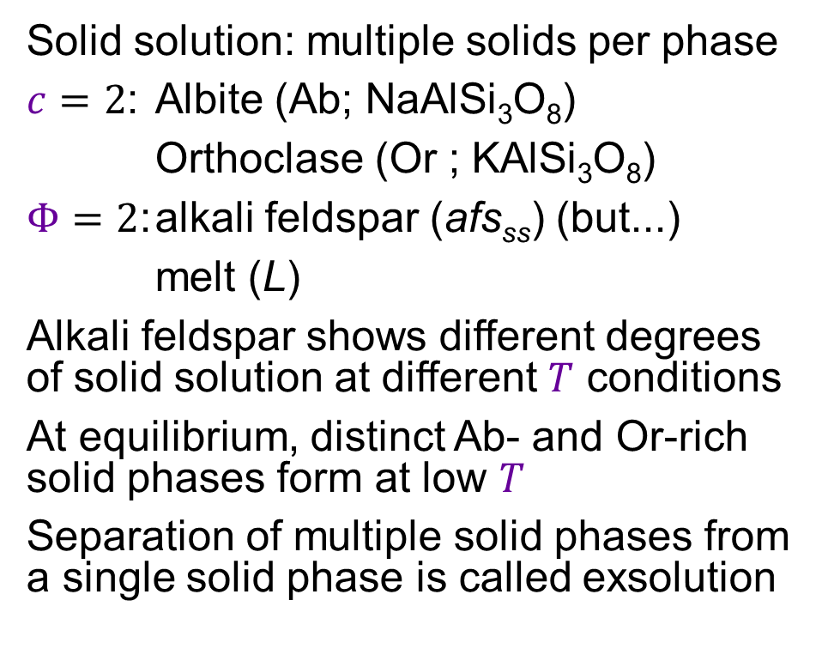
Binary phase diagram with a solvus: Ab–Or
Solid solution: multiple solids per phase
$c=2$: Albite (Ab; NaAlSi₃O₈)
Orthoclase (Or ; KAlSi₃O₈)
$Φ=2$: alkali feldspar (afs_{ss}) (but...)
melt (L)
Alkali feldspar shows different degrees of solid solution at different $T$ conditions
At equilibrium, distinct Ab- and Or-rich solid phases form at low $T$
Separation of multiple solid phases from a single solid phase is called exsolution

Slide 18

Binary phase diagram with a solvus: Ab–Or
L
Equilibrium crystallisation
First alkali feldspar is Ab-rich
L → Ab-rich afs_{ss} (liquidus)
Alkali feldspar and melt become richer in Or until the solid reaches the system composition
The system cools to the solvus, where Or-rich afs_{ss} progressively exsolves from the Ab-rich afs_{ss}
Proportions of Ab- and Or-rich afs_{ss} are given by the lever rule
System
L1
T1
Liquid
L2
T2
Ab-rich afs_{ss}
Ab-rich afs_{ss}
Or-rich afs_{ss}
T3
System
a
b

Slide 19
Binary phase diagram with a solvus: Ab–Or
L
Liquid
=
System
Fractional crystallisation
First alkali feldspar is Ab-rich
L → Ab-rich afs_{ss} (liquidus)
Alkali feldspar is removed from the system; melt reaches the eutectic
L → eutectic afs_{ss} (liquidus)
The system cools to the solvus and exsolution occurs (at equilibrium)
Once solid, the composition of the system cannot change
L1
T1
L2
T2
Ab-rich afs_{ss}
T3
Ab-rich afs_{ss}
Or-rich afs_{ss}
System
Exsolution depends on cooling rate; we’ll discuss this with pyroxenes next

Slide 20
Melting and crystallisation in geochemical systems: phase diagram applications
EART26201 | Principles of Geochemistry | Lecture 4
Part 4 | Pyroxenes and exsolution

Slide 21
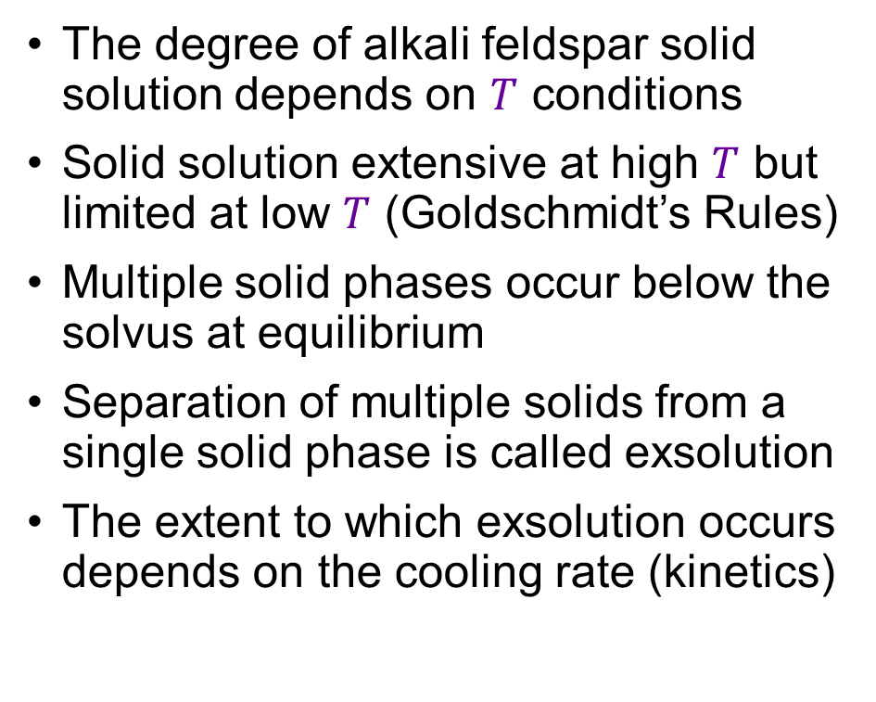
Binary phase diagram with a solvus: a recap
The degree of alkali feldspar solid solution depends on $T$ conditions
Solid solution extensive at high $T$ but limited at low $T$ (Goldschmidt’s Rules)
Multiple solid phases occur below the solvus at equilibrium
Separation of multiple solids from a single solid phase is called exsolution
The extent to which exsolution occurs depends on the cooling rate (kinetics)
We’ll discuss kinetics more in Lecture 5

Slide 22

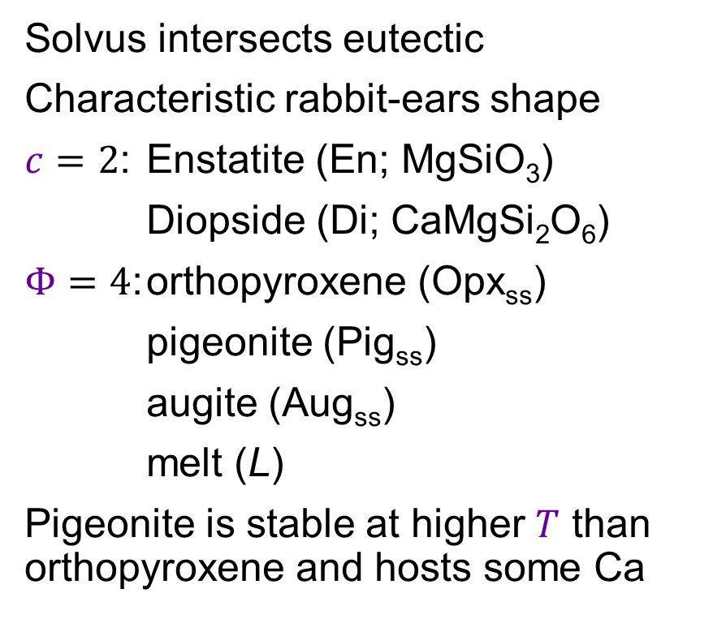
Phase diagrams and mineral textures: pyroxenes
Solvus intersects eutectic
Characteristic rabbit-ears shape
$c=2$: Enstatite (En; MgSiO₃)
Diopside (Di; CaMgSi₂O₆)
$Φ=4$: orthopyroxene (Opx_{ss})
pigeonite (Pig_{ss})
augite (Aug_{ss})
melt (L)
Pigeonite is stable at higher $T$ than orthopyroxene and hosts some Ca

Slide 23

Phase diagrams and mineral textures: pyroxenes
L
Slow cooling (equilibrium)
Di-rich augite is the first solid to crystallise
Melt and augite become richer in En until the eutectic is reached, where Di-poor pigeonite and Di-rich augite crystallise
Once the system has solidified, augite exsolves from pigeonite and vice versa
  Augite becomes richer in Di
  Pigeonite becomes poorer in Di
Eventually, Di-rich pigeonite undergoes a phase transition to Di-poor orthopyroxene
Orthopyroxene exsolves from augite and vice versa, changing compositions further
System
T1
L1
Liquid
Aug_{ss}
L2
T2
Pig_{ss}
Aug_{ss}
T3
Opx_{ss}
Aug_{ss}

Slide 24
Phase diagrams and mineral textures: pyroxenes
L
Moderate cooling (close to equilibrium)
Di-rich augite is the first solid to crystallise
Melt and augite become richer in En until the eutectic is reached, where Di-poor pigeonite and Di-rich augite crystallise
Once the system has solidified, augite exsolves from pigeonite and vice versa
  Augite becomes richer in Di
  Pigeonite becomes poorer in Di
However, exsolution takes time (kinetics) and may not run to completion
Di-rich Pigeonite does not go through phase transition to Di-poor orthopyroxene
System
T1
L1
Liquid
Aug_{ss}
L2
T2
Pig_{ss}
Aug_{ss}

Slide 25
Phase diagrams and mineral textures: pyroxenes
L
Fast cooling (far from equilibrium)
Di-rich augite is the first solid to crystallise
Melt and augite become richer in En until the eutectic is reached, where Di-poor pigeonite and Di-rich augite crystallise
No exsolution occurs during fast cooling
Augite and pigeonite are homogenous and retain compositions from eutectic
Di-rich pigeonite does not go through phase transition to Di-poor orthopyroxene
System
T1
L1
Liquid
Aug_{ss}
L2
T2
Pig_{ss}
Aug_{ss}

Slide 26
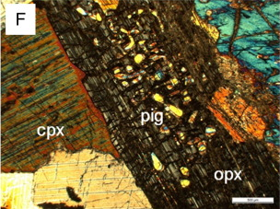
Phase diagrams and mineral textures: pyroxenes
Slow cooling (equilibrium)
Augite and/or orthopyroxene with exsolution lamellae of each other
‘Inverted pigeonite’ is often found in large fossil magma chambers
Pig_{ss}
Aug_{ss}
McDonald et al. (2017)
Opx_{ss}
Aug_{ss}
Thick augite lamellae
Orthopyroxene that
used to be pigeonite,
i.e. ‘inverted pigeonite’

Slide 27
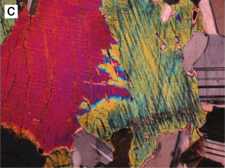
Phase diagrams and mineral textures: pyroxenes
Moderate cooling (close to equilibrium)
Augite and/or pigeonite with exsolution lamellae of each other
Crystals with exsolution lamellae (but no orthopyroxene) are found in small fossil magma chambers
Pig_{ss}
Aug_{ss}
Thin pigeonite lamellae
Augite crystals
Humphreys & Holness (2010)

Slide 28
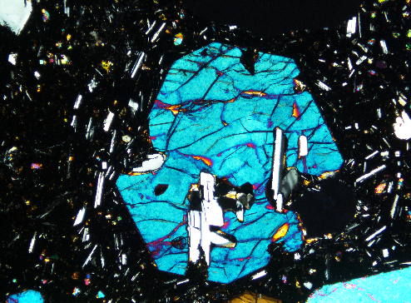
Phase diagrams and mineral textures: pyroxenes
Fast cooling (far from equilibrium)
Homogenous augite and/or pigeonite without exsolution lamellae
Homogenous crystals are commonly found in volcanic rocks (i.e. lavas)
Pig_{ss}
Aug_{ss}
Homogenous
augite crystal

Slide 29
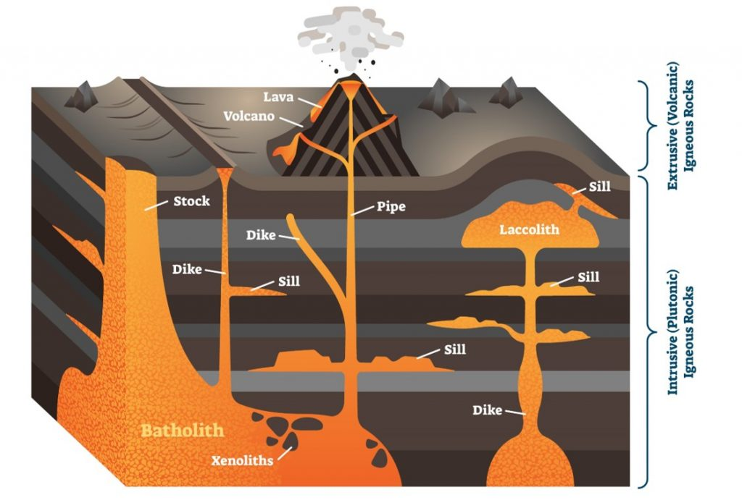
Which pyroxene grows where?

Slide 30
Melting and crystallisation in geochemical systems: phase diagram applications
EART26201 | Principles of Geochemistry | Lecture 4
Part 5 | Binary phase diagrams with a peritectic

Slide 31
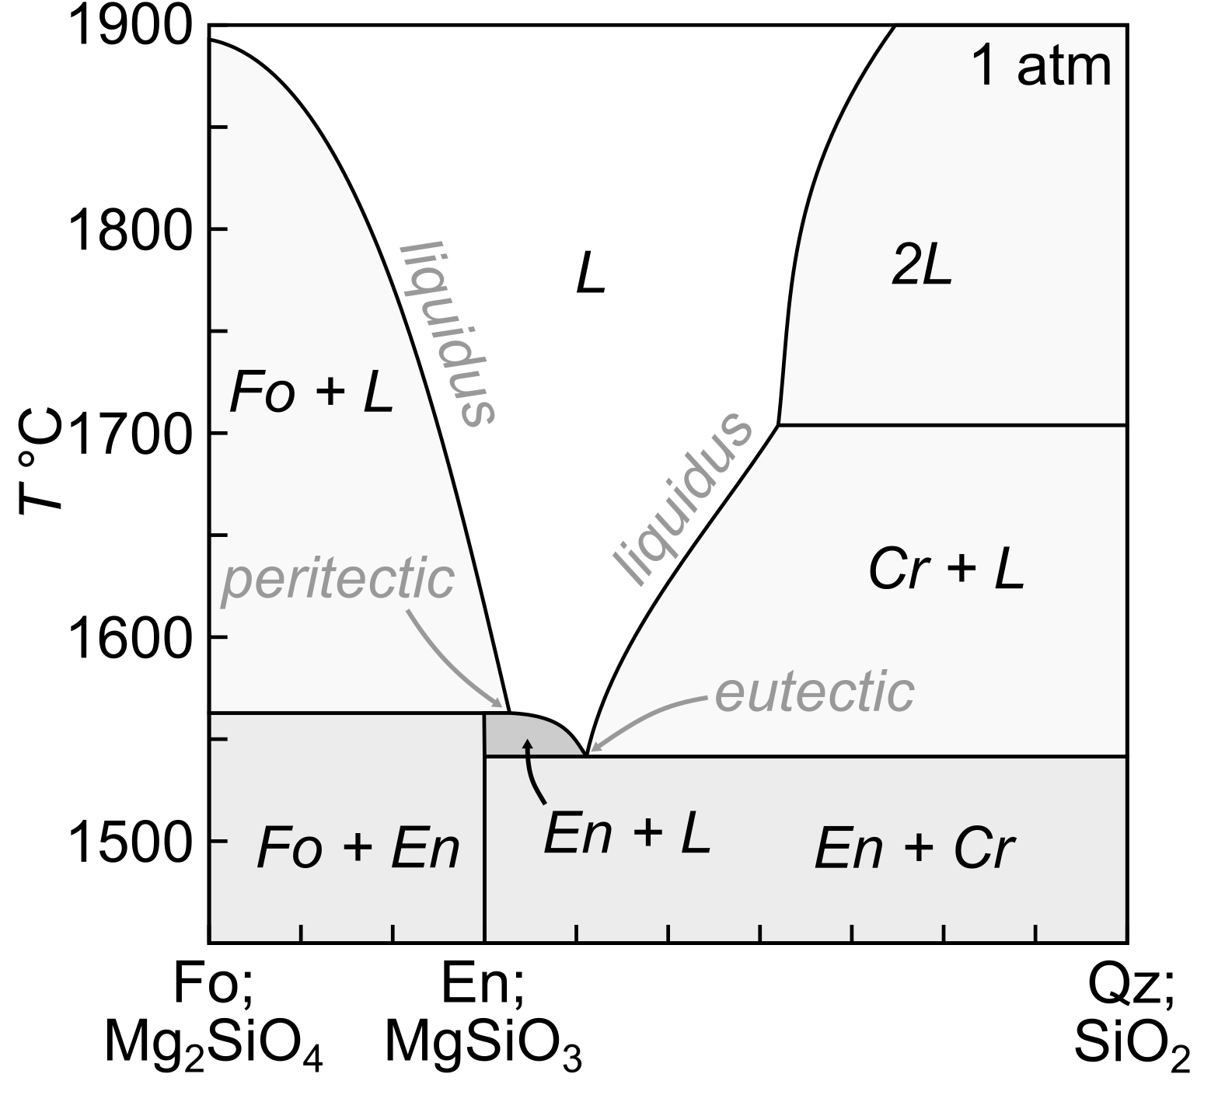
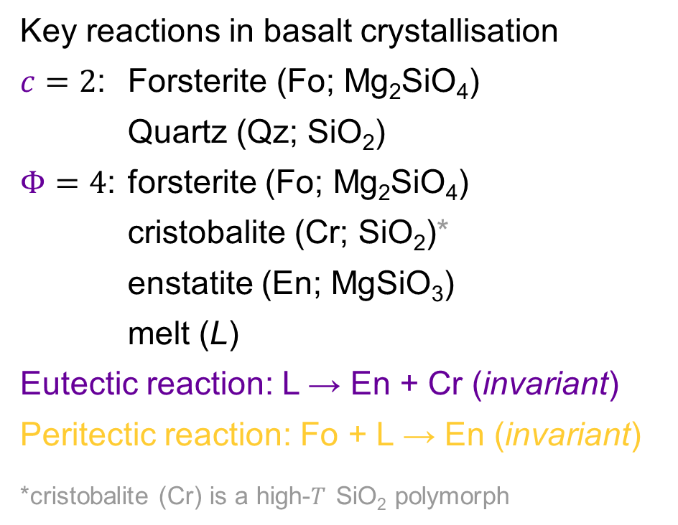
Binary phase diagram with a peritectic: Fo–Qz
Focus on this part
Key reactions in basalt crystallisation
$c=2$: Forsterite (Fo; Mg₂SiO₄)
Quartz (Qz; SiO₂)
$Φ=4$: forsterite (Fo; Mg₂SiO₄)
cristobalite (Cr; SiO₂)*
enstatite (En; MgSiO₃)
melt (L)
Eutectic reaction: L → En + Cr (invariant)
Peritectic reaction: Fo + L → En (invariant)
*cristobalite (Cr) is a high-$T$ SiO₂ polymorph

Slide 32
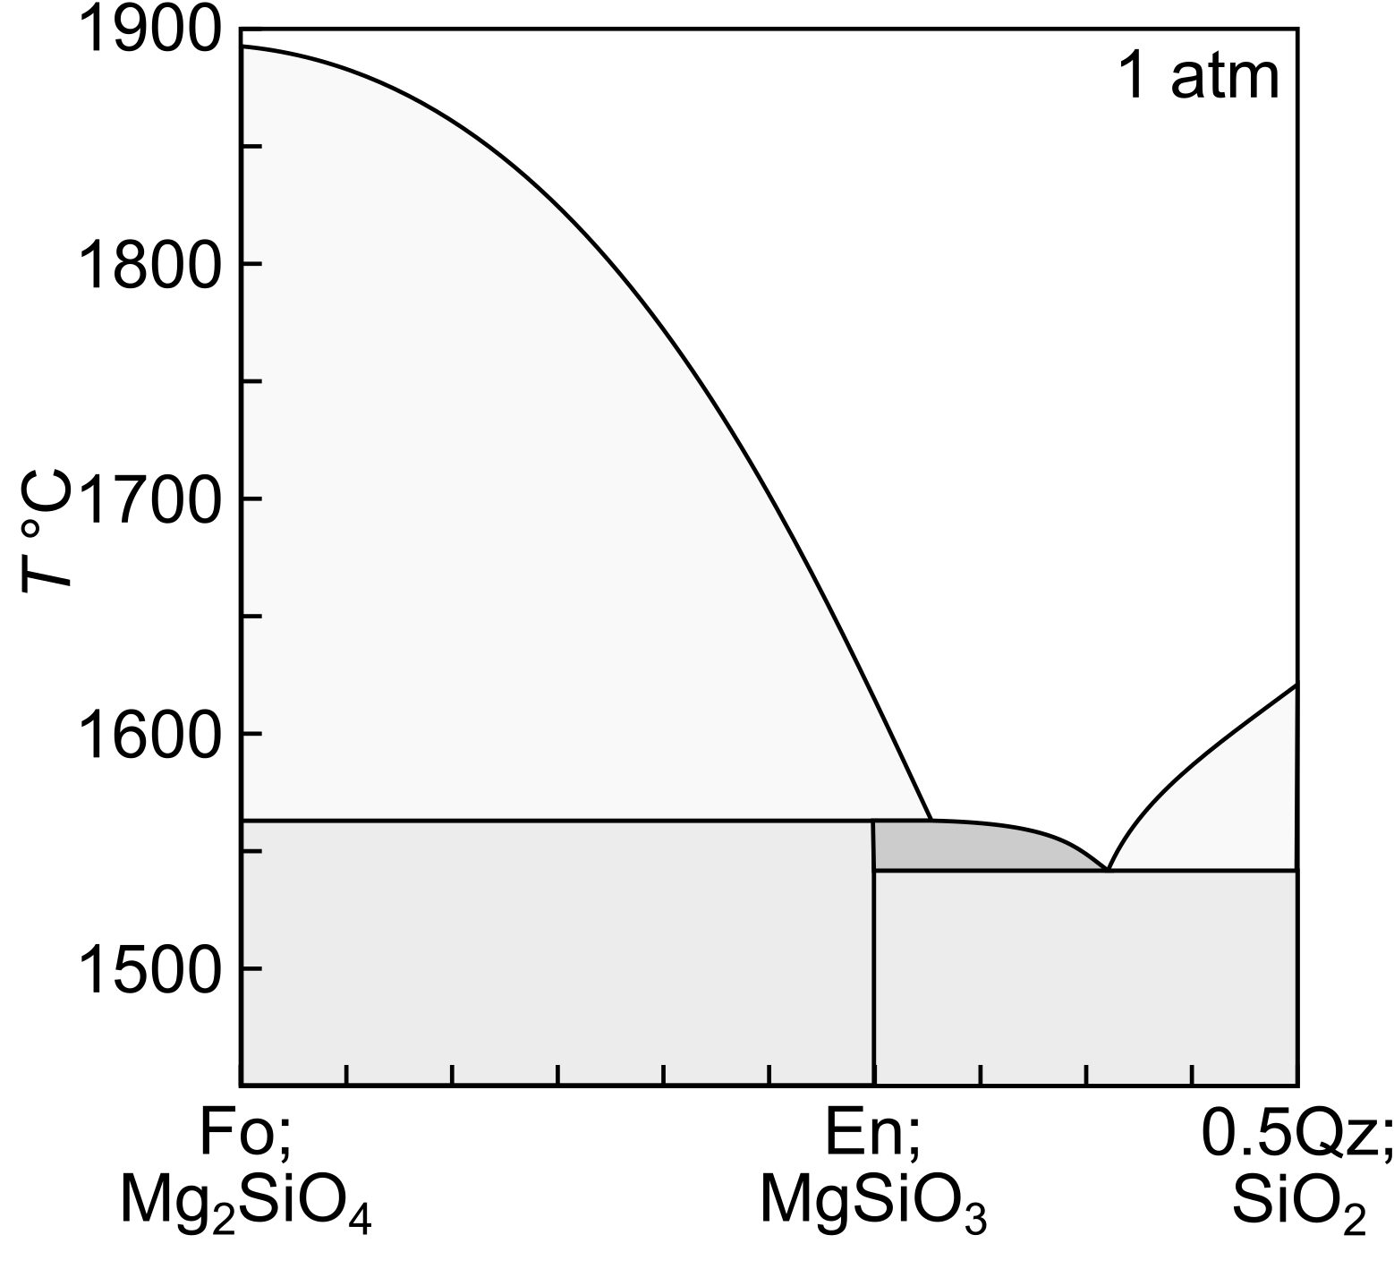
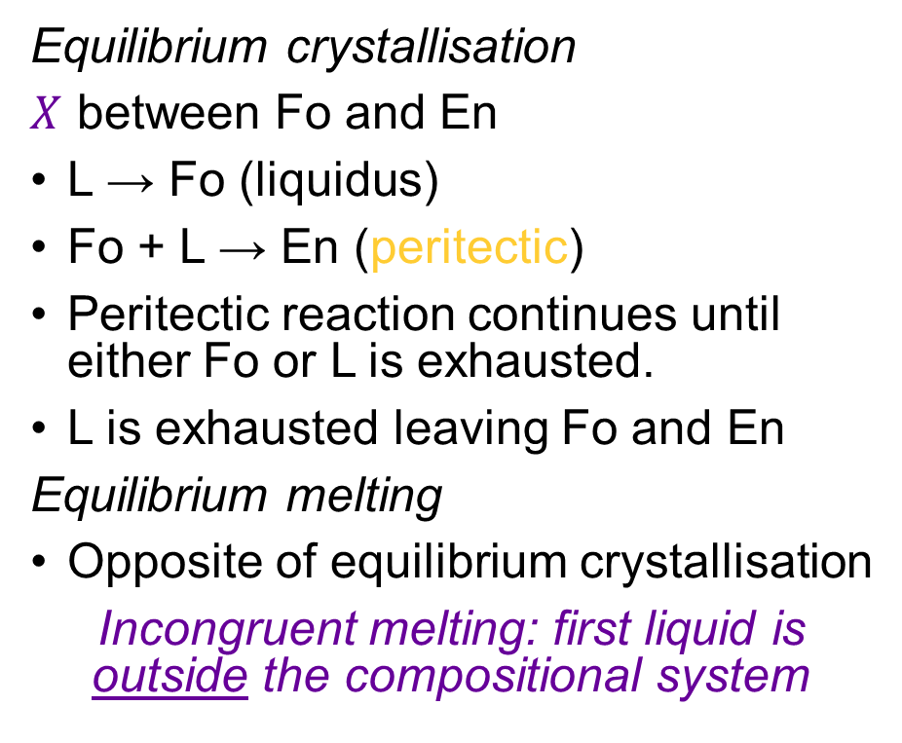
Binary phase diagram with a peritectic: Fo–Qz
Equilibrium crystallisation
$X$ between Fo and En
L → Fo (liquidus)
Fo + L → En (peritectic)
Peritectic reaction continues until either Fo or L is exhausted.
L is exhausted leaving Fo and En
Equilibrium melting
Opposite of equilibrium crystallisation
Incongruent melting: first liquid is outside the compositional system
L
L
T1
Fo
L1
Fo+L
Liquid
System
En+L
T2
Fo
En
L2
Cr+L
Fo+En
En+Cr
T3
Fo
En

Slide 33
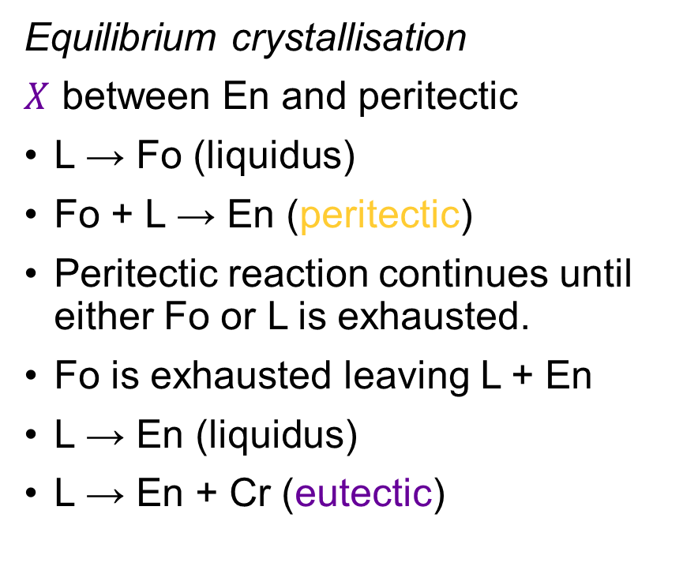
Binary phase diagram with a peritectic: Fo–Qz
Equilibrium crystallisation
$X$ between En and peritectic
L → Fo (liquidus)
Fo + L → En (peritectic)
Peritectic reaction continues until either Fo or L is exhausted.
Fo is exhausted leaving L + En
L → En (liquidus)
L → En + Cr (eutectic)
L
L
Fo+L
En+L
T1
Fo
L1
Cr+L
Fo
En
L2
T2
L3
T3
En
Cr
Fo+En
En+Cr
T4
En
Cr

Slide 34
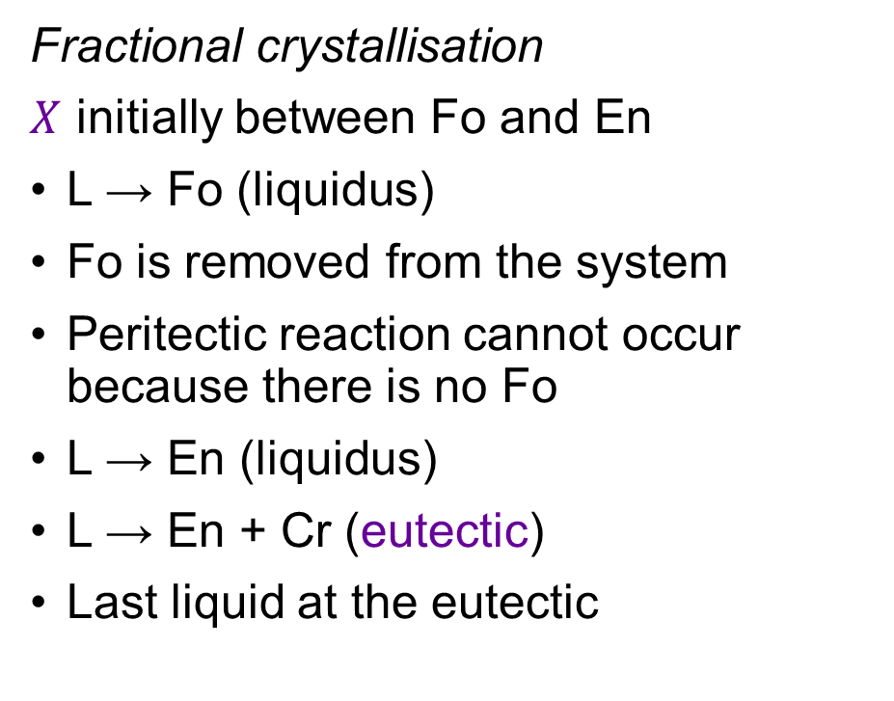
Binary phase diagram with a peritectic: Fo–Qz
Fractional crystallisation
$X$ initially between Fo and En
L → Fo (liquidus)
Fo is removed from the system
Peritectic reaction cannot occur because there is no Fo
L → En (liquidus)
L → En + Cr (eutectic)
Last liquid at the eutectic
L
L
T1
Fo
L1
Fo+L
Liquid
=
System
En+L
L2
Cr+L
T2
En
T3
L3
Fo+En
En
Cr
En+Cr
T4
En
Cr

Slide 35
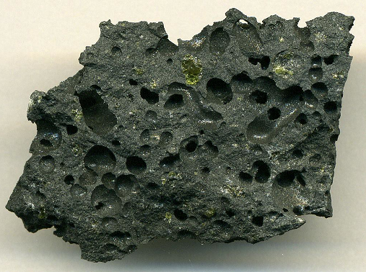
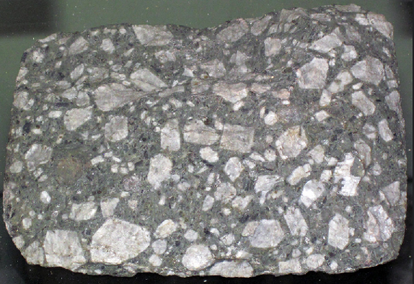
But do peritectic reactions occur in nature?
Peritectic reactions are rarely observed in natural magmas
Fractional crystallisation dominates
Start Fo rich but end Fo free
But what about equilibrium crystallisation in closed systems?
Basalt: Fo
Dacite: En + Qz

